Slide 1

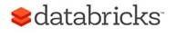

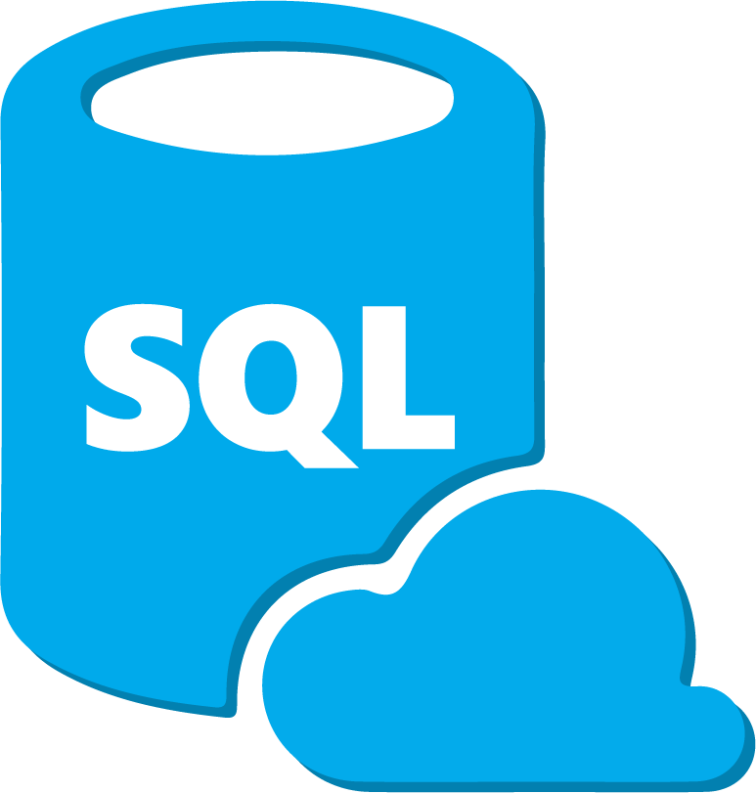

Azure Databricks SQL Deep Dive Bryan Cafferky Data Solutions Enabler
https://github.com/bcafferky/shared

Slide 2




About Bryan Cafferky…
Microsoft Data and AI Solutions Enabler for Healthcare Customers
Decades of IT Experience
Past Microsoft Data Platform MVP and Cloud and Data Center MVP
Author of Pro PowerShell for Database Developers
Experienced in health care, insurance, banking, and ecommerce
Founded and lead PASS Chapter The RI Microsoft BI User Group and The Boston Data Science Group
https://www.linkedin.com/in/bryancafferky
Subscribe to my YouTube Channel

Slide 3
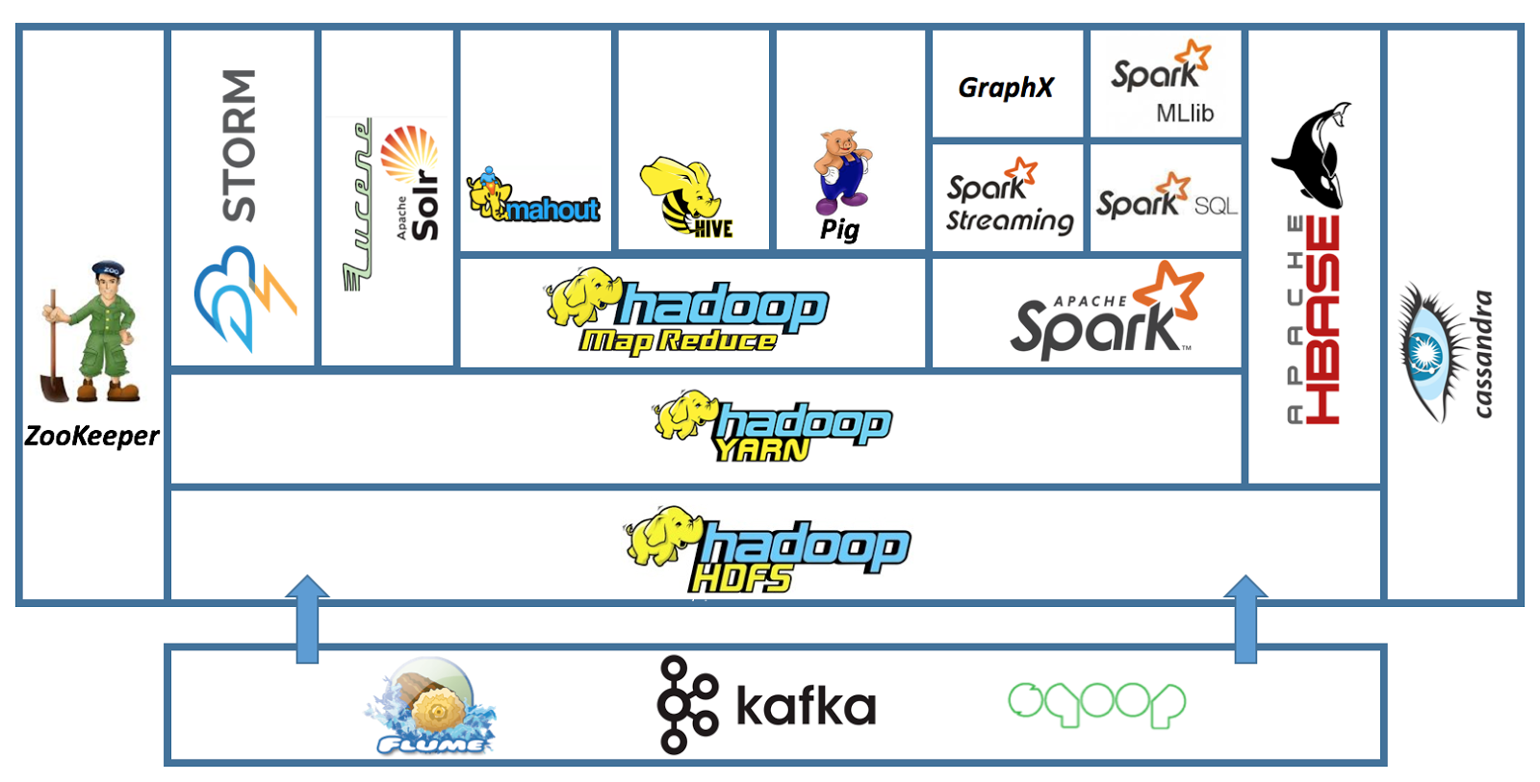
The Apache Hadoop Ecosystem
Databricks
HDInsight
In Memory MPP
NoSQL
Storage
Streaming
Distributed
System
Coordination
Full Text
Search
ETL
Machine Learning
SQL
Real Time
H
a
d
o
o
p
B
A
T
C
H
Queuing Service
Move Data to/From SQL Databases
Streaming

Slide 4




Azure
Easy
Cluster Creation
Scheduling
Big Data
Databricks IDE
Notebooks
Security
Collaboration

Slide 5
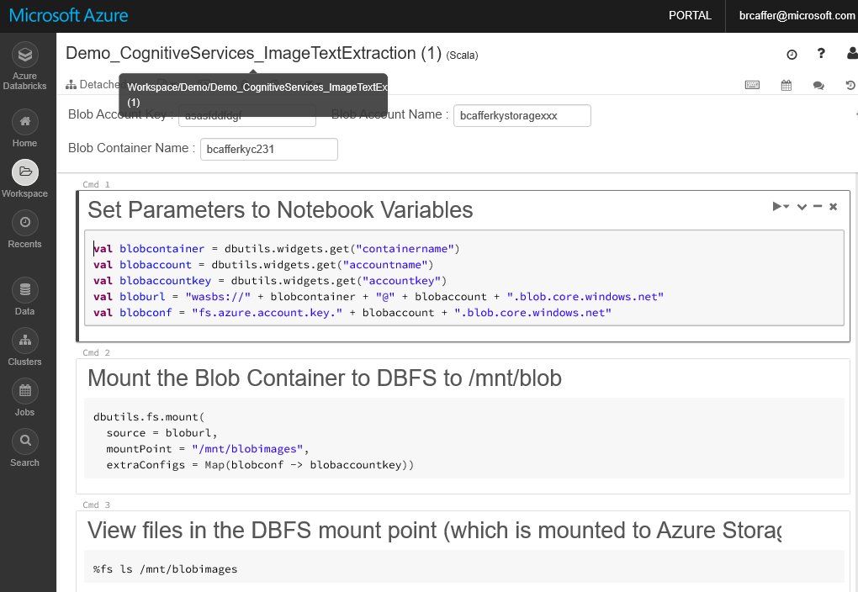
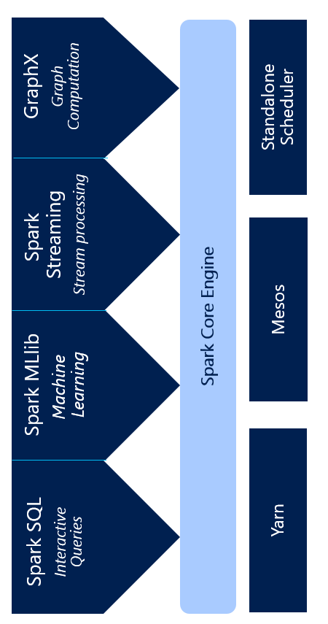
Azure Databricks
Notebooks
Integrated Blob File System
Secure Collaboration
Click Cluster Creation
Job Scheduler
Language Extensions
Spark Optimizations

Slide 6
Apache Spark
An unified, open source, parallel, data processing framework for Big Data Analytics
Spark SQL
Interactive Queries
Spark MLlib
Machine Learning
Spark Streaming
Stream processing
GraphX
Graph Computation
Spark Unifies:
Batch Processing
Interactive SQL
Real-time processing
Machine Learning
Deep Learning
Graph Processing
Spark Core Engine
Yarn
Mesos
Standalone Scheduler
Spark MLlib
Machine Learning
Spark Structured Streaming
Stream processing

Slide 7




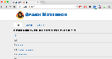
Azure Databricks Core ARTIFACTS
Clusters
Libraries
Workspaces
Azure Databricks
Jobs
Notebooks

Slide 8
General Spark Cluster Architecture
Driver Program SparkContext
‘Driver’ runs the user’s ‘main’ function and executes the various parallel operations on the worker nodes.
The results of the operations are collected by the driver
The worker nodes read and write data from/to Data Sources including HDFS.
Worker node also cache transformed data in memory as RDDs (Resilient Data Sets).
Worker nodes and the Driver Node execute as VMs in public clouds (AWS, Google and Azure).
Cluster Manager
Worker Node
Worker Node
Worker Node
Cache
Cache
Cache
Task
Task
Task
Data Sources (HDFS, SQL, NoSQL, …)

Slide 9
Azure Databricks SQL Deep Dive

Slide 10
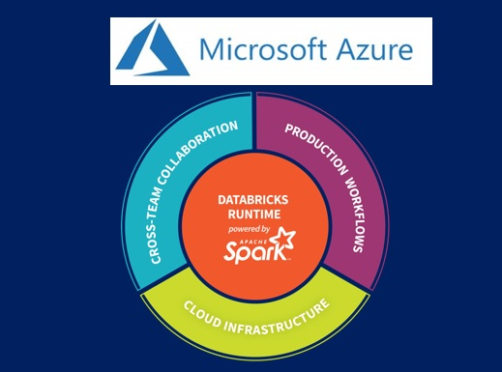
Azure Databricks SQL Deep Dive
Bryan Cafferky Technical Solutions Professional

